Slide 1
Real-Time Eulerian Fluid Sim
Ishan Ranade and Salaar Kohari
Real-Time Eulerian Water Simulation Using a Restricted Tall Cell Grid
Nuttapong Chentanez and Matthias Muller
NVIDIA PhysX Research

Slide 2
Beta
Renders fluid simulation with sphere marching
Blinn-Phong shading with normal approximation
CUDA and algorithm optimizations

Slide 3
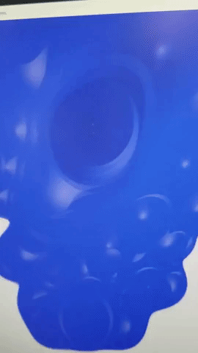
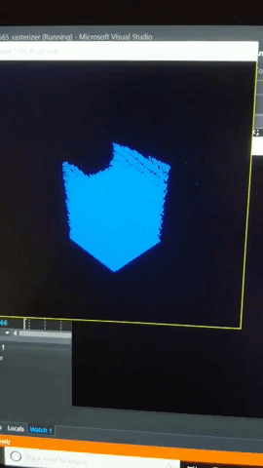
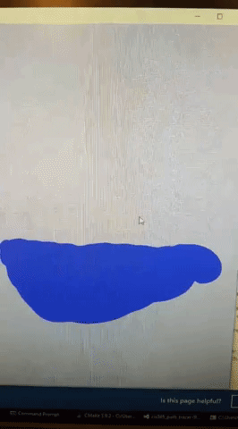
Rendering

Slide 4
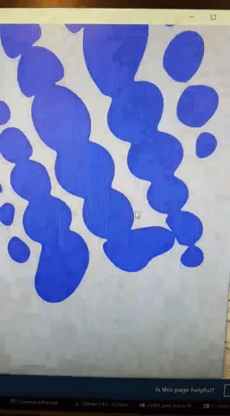
Rendering

Slide 5
Rendering

Slide 6
Problem Areas
Hierarchical multigrid pressure solver since Conjugate Gradient Method is too slow
May try CPU solver instead until we get it working

Slide 7
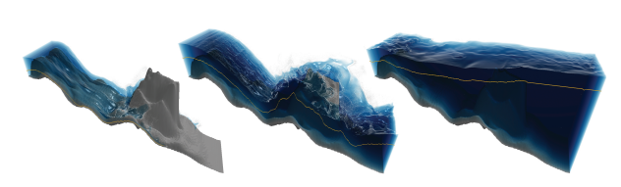
Remaining Work
Notes:
Explain that this counts for CIS 563

Slide 8
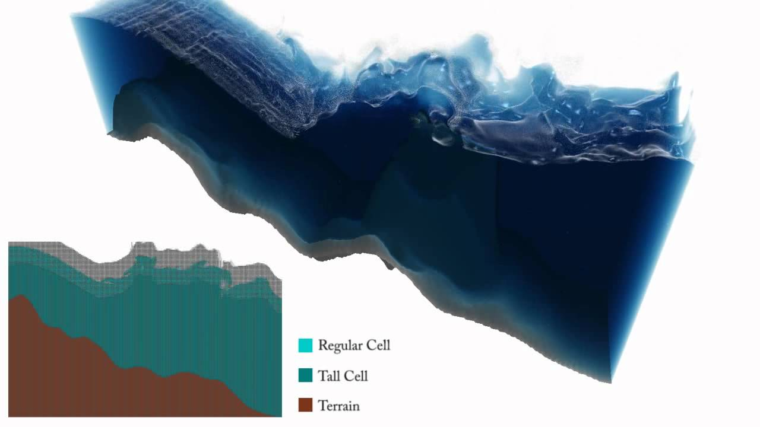
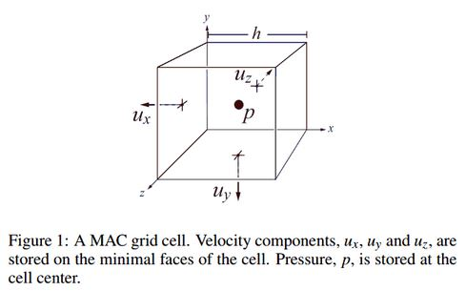
Tall Cells
Adaptive MAC grid with tall cells to reduce computation below the surface
Transition cells between regular and tall depending on distance to surface

Slide 9
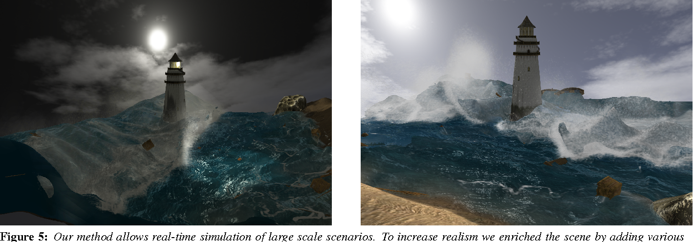
Textures
Use water/wave textures with modification depending on surface deformation and velocity

Slide 10
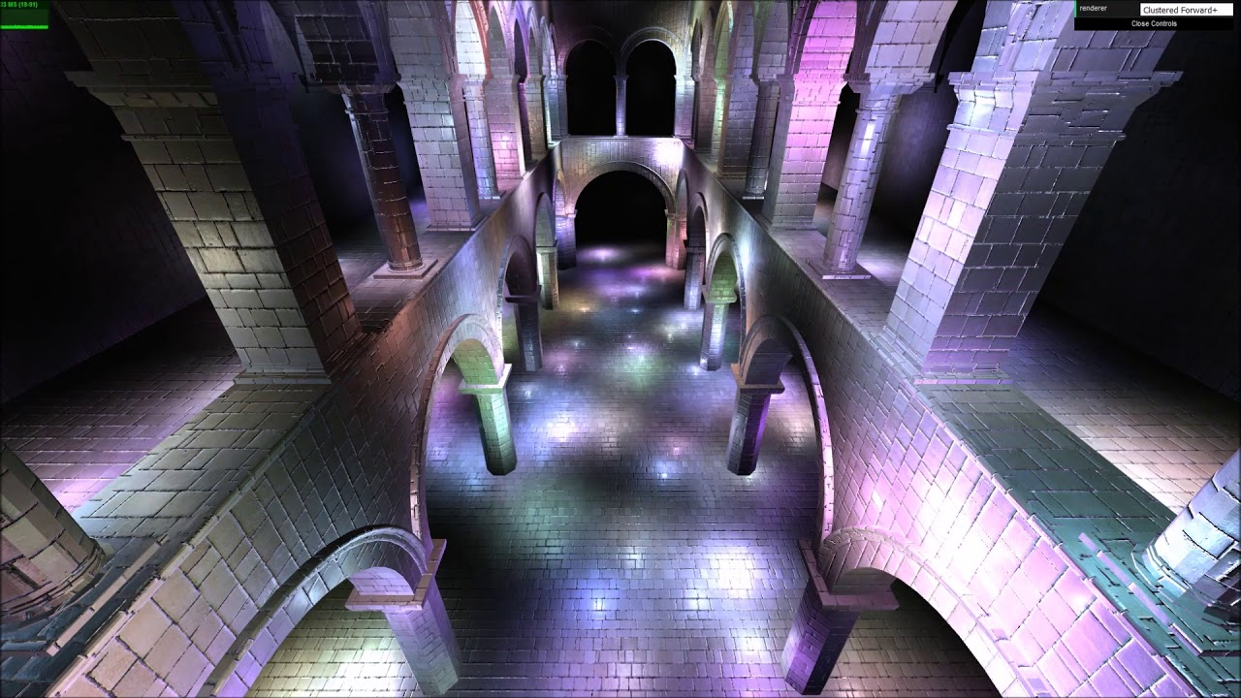
Clustering
Use marker particle clusters to reduce cost of sphere marching

Slide 11

Scalability
Allow for real-time water simulation in a larger environment
Blend fake/simple simulation with main simulation

Slide 12
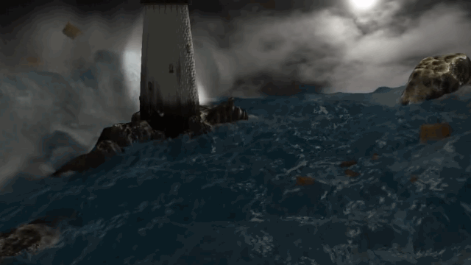
Notes:
Talk about simulation, real-time, rendering, interactive water and boxes

